Slide 1

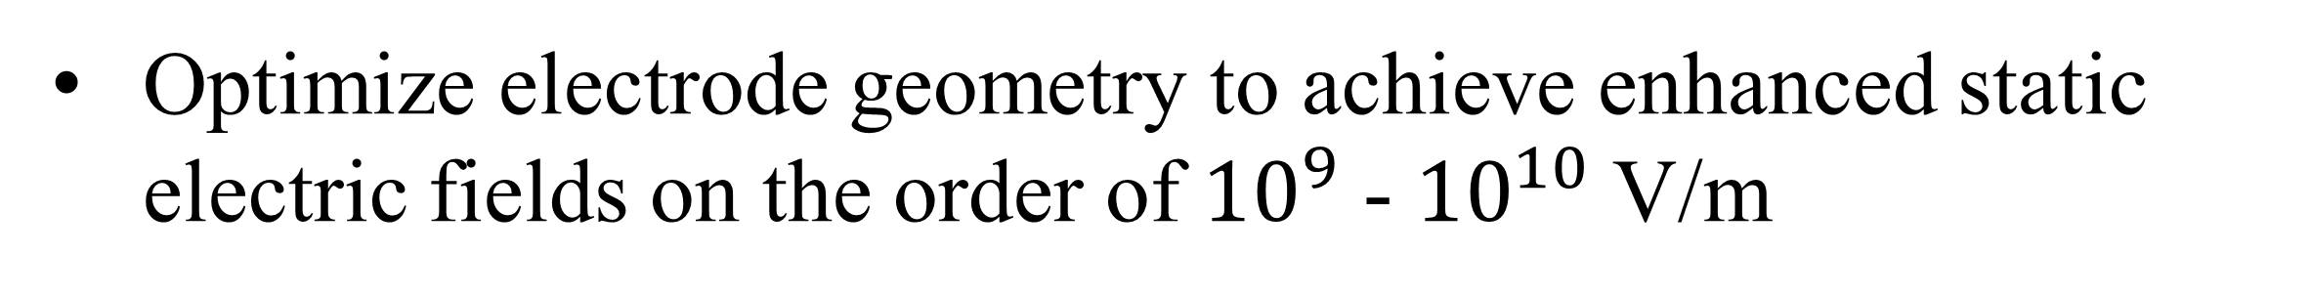
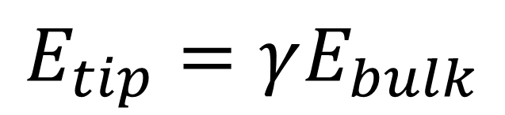
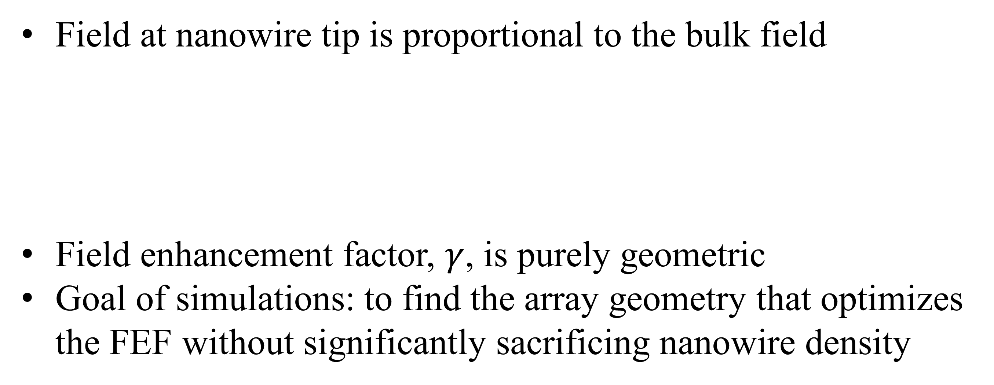
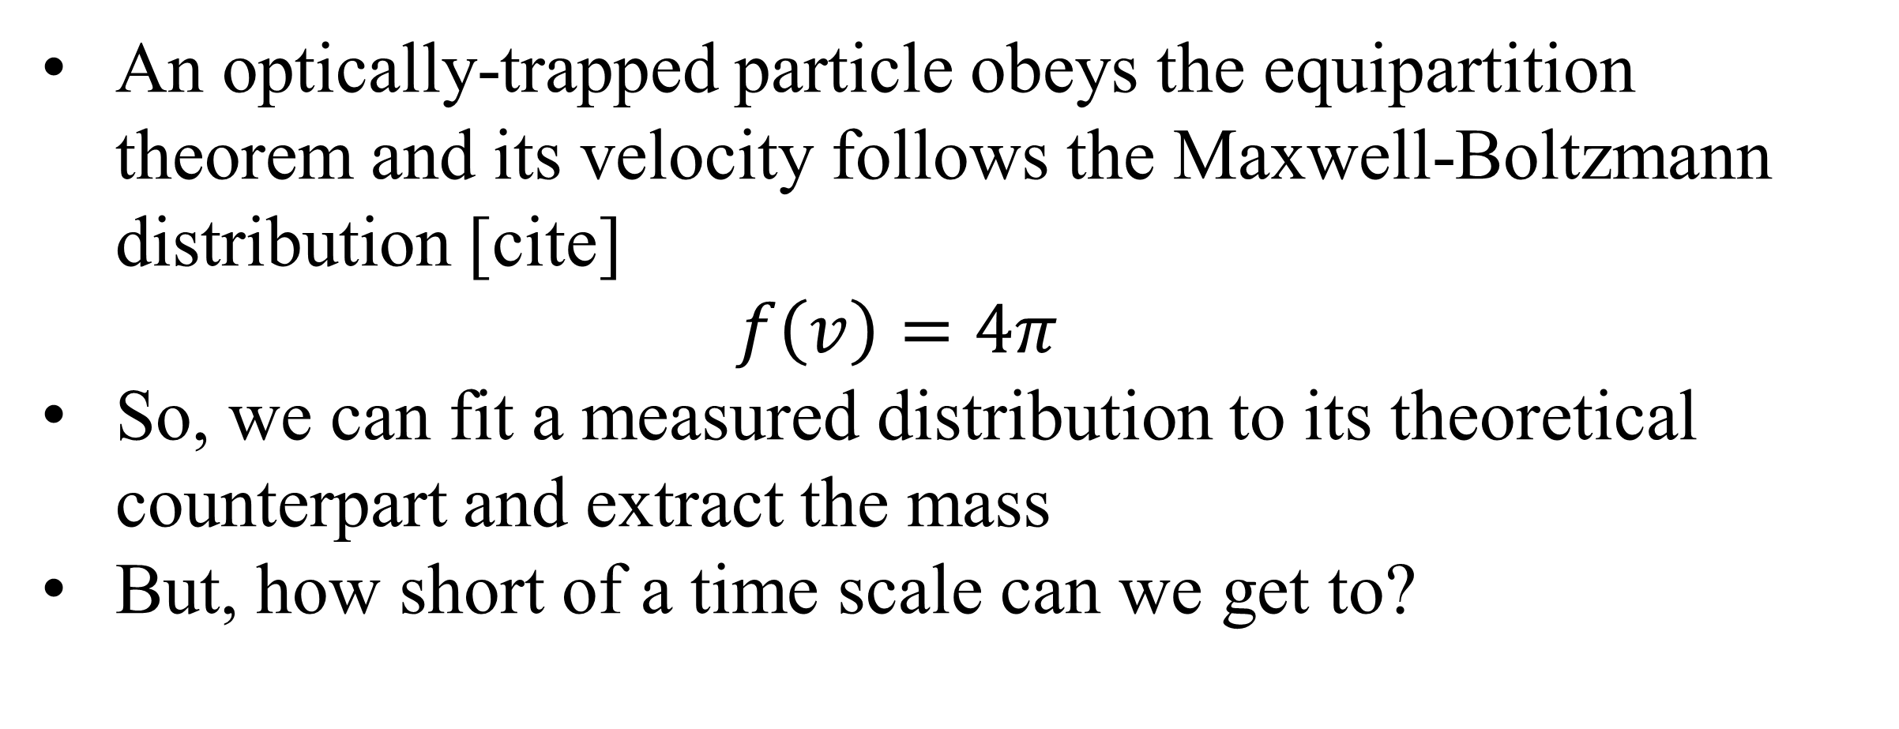
Using the instantaneous velocity of a Brownian particle in an optical tweezer to measure changes in mass
Gabriel H. Alvarez*, Julia E. Orenstein, Lichung Ha, Diney S. Ether Jr., Mark G. Raizen
University of Texas at Austin (*Stanford University)
Motivation
Simulation results
Noise Canceling
An optically-trapped particle obeys the equipartition theorem and its velocity follows the Maxwell-Boltzmann distribution [cite]
$$f\left(v\right)=4π$$
So, we can fit a measured distribution to its theoretical counterpart and extract the mass
But, how short of a time scale can we get to?
Field at nanowire tip is proportional to the bulk field
Field enhancement factor, $γ$, is purely geometric
Goal of simulations: to find the array geometry that optimizes the FEF without significantly sacrificing nanowire density
Field at nanowire tip is proportional to the bulk field
$$E_{tip}=γE_{bulk}$$
$$E_{tip}=γ\frac{V_{0}}{d}$$
Experimental Setup
Optimize electrode geometry to achieve enhanced static electric fields on the order of ${10}^{9}$ - ${10}^{10}$ V/m
Toward observing ice nucleation
References
H Karaagac, MS Islam. Adv. Funct. Mater. 24 (2014), 2224-223.2
RB Sadeghian, MS Islam. Nat. Mater. 10 (2011), 135-140.
Read, Bowring. Nucl. Instr. Meth. Phys. A. 519 (2004) 305-314.
KS Selinidis, CB Brooks, et. al. “Progress in mask replication using jet and flash imprint lithography” 2011
Z Ye, CB Brooks, et. al. “High density patterned media fabrication using jet and flash imprint lithography” 2011.

